Slide 1
RNA and Protein Synthesis
Chapter 11

Slide 2
What are Genes?
Genes are coded DNA instructions that control the production of proteins within the cell

Slide 3
Central Dogma
Transcription
DNA
RNA
Proteins
Occurs in the Nucleus

Slide 4
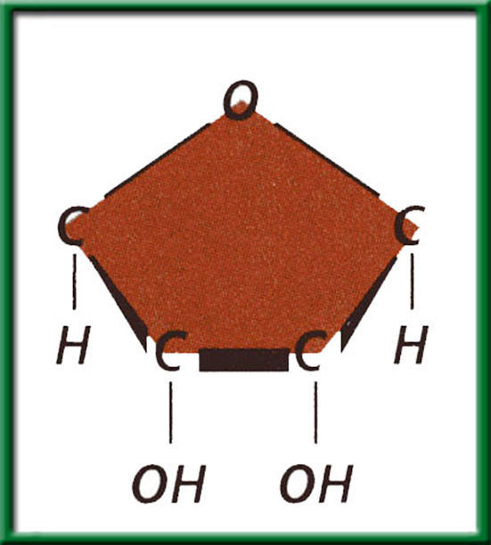
What is RNA?
Similar to DNA EXCEPT it differs in 3 ways :
The Sugar in RNA is ribose instead of deoxyribose

Slide 5
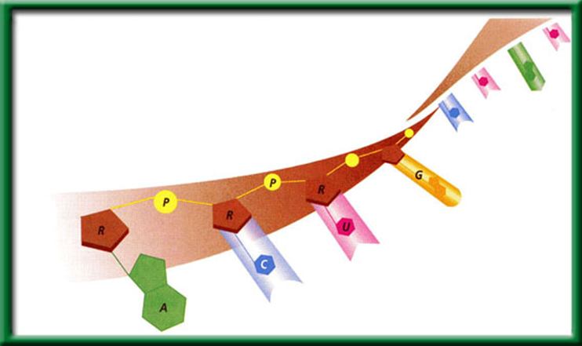
What is RNA?
Similar to DNA EXCEPT it differs in 3 ways :
RNA is single stranded (not double stranded
like DNA)

Slide 6
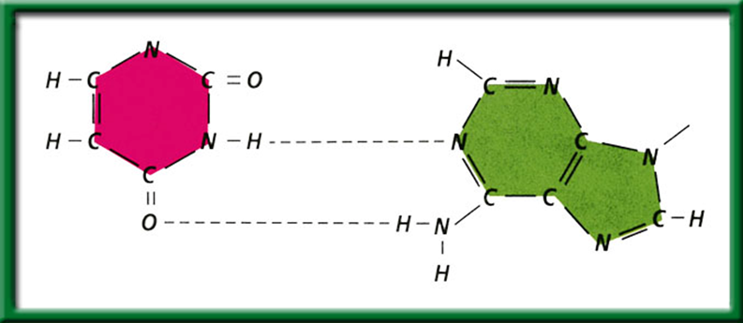
What is RNA?
Similar to DNA EXCEPT it differs in 3 ways :
RNA contains the nitrogen base Uracil
instead of Thymine (but it’s still a pyrimadine)
In RNA
There is no Thymine
Adanine bonds to Uracil
A – U
Uracil
Adenine
Let’s make an RNA strand
DNA | A | T | G | C | A | C
mRNA
U
A
C
G
U
G

Slide 7
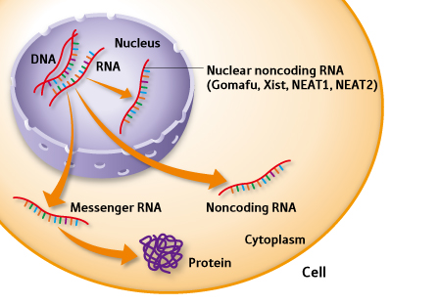
Why use RNA?
RNA is a throw away copy of DNA that can leave the nucleus
DNA can not leave the nucleus
RNA can!!

Slide 8
Types of RNA
There are 3 types of RNA:
Messenger RNA (mRNA)
  Carry copies of instructions for the assembly of amino acids into proteins
  Serve as “messengers” from DNA to the rest of the cell
Ribosomal RNA (rRNA)
  Helps build ribosomes
Transfer RNA (tRNA)
  Transfers the amino acid to the ribosome

Slide 9
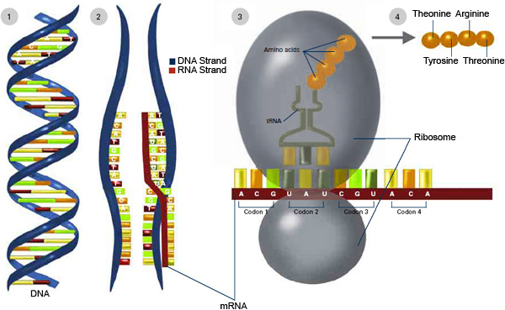
Protein Synthesis
Consists of 2 main stages:
Transcription
  Takes place in the nucleus.
Translation
  Takes place
  in the
  ribosome.

Slide 10
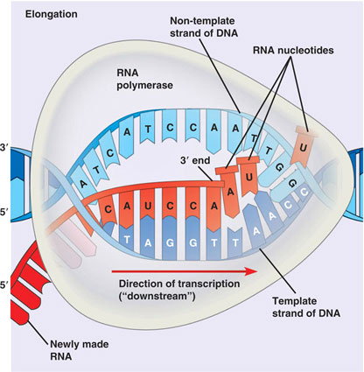
Transcription
This is the stage where the RNA is made from a strand of DNA using the enzyme RNA polymerase. This occurs in the nucleus of the eukaryotic cell.

Slide 11
What happens during transcription?
The RNA polymerase will bind to the DNA at a specific site known as the promoter. ( the start signal region of DNA)
RNA polymerase will unwind the DNA helix and separate the 2 strands.
RNA polymerase moves along the DNA using one strand of DNA as a template and base pairs a new RNA strand until it reaches a STOP codon and falls off.
The DNA then rewinds itself back into a helix

Slide 12
