Slide 1
Proteins
The multi-taskers

Slide 2
What elements are Proteins composed of?
Carbon (C)
Hydrogen (H)
Oxygen(O)
Nitrogen (N)

Slide 3
Functions in living organisms
Construction materials for body parts like bones, muscles and blood.
Fight disease
Regulate cell Processes

Slide 4
Protein Monomers (Building Blocks)
Amino acids are the building blocks that make up most proteins
There are 20 different kinds of amino acids that humans use.
Composed of :
An Amino Group ( -NH₂)
&
A Carboxyl Group (-COOH)

Slide 5
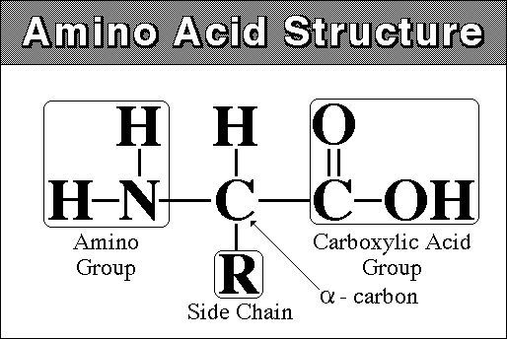
Protein Monomers (Building Blocks)

Slide 6
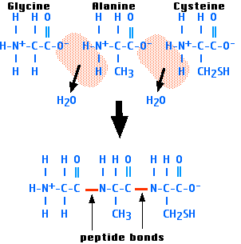
Protein Polymers
Proteins = Polypeptide Chain
Amino Acids
Protein
(polypeptide

