Slide 1
Today you will need:
Colored pencils
Your cell cycle foldable
Something to write with
A ruler

Slide 2
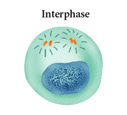
Mitosis

Slide 3
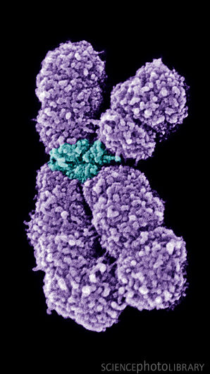
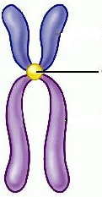
What are Chromosomes?
Chromosomes
Carry the genetic information (traits) that are passed on from one generation of cells to the next.
Chromatids
A chromatid is one half of a chromosome
Each pair of chromatids is attached at an area called the centromere.
Centromere
Sister Chromatids

Slide 6
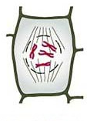
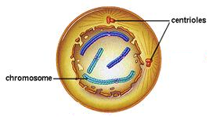
Prophase
Significant Events
Plant
Nuclear Envelope breaks down
Nucleolus disappears
Chromosomes become visible
*Centrioles move to the poles of the cell (Animals Only)
Nuclear Envelope
Animal

Slide 7
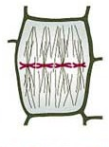
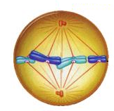
Metaphase
Significant Events
Plant
Chromosomes line up across the center of the cell (metaphase plate)
Spindle fibers (apparatus) connect to each chromosome at the centromere
Spindle
Animal

Slide 8
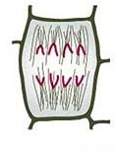
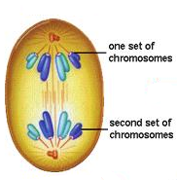
Anaphase
Significant Events
Plant
Chromosomes are separated and pulled to opposite sides of the cell by the spindle fibers
This phase ends when the chromosomes stop moving
Animal

Slide 9
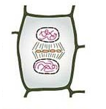
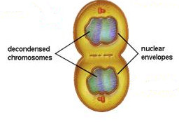
Telophase
Significant Events
Plant
Chromosomes uncoil
Two new nuclear envelopes form
Mitosis is complete, cell division is not.
CYTOKINESIS
Division of the cytoplasm
Occurs at the same time as telophase
Plants: Cell plate forms
Animals: Cleavage furrow forms
Animal

Slide 10
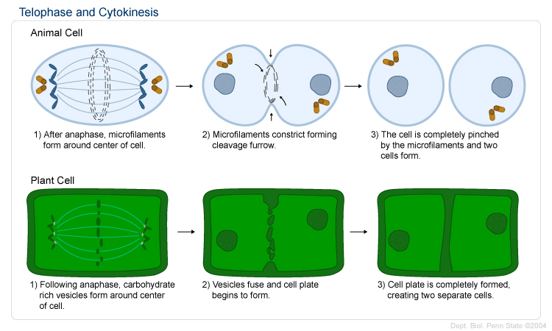
Cytokinesis
Animal
Plant
VS.
The cell membrane pinches in to form a cleavage furrow
A cell plate forms midway between the divided nuclei.

Slide 11
P
M
A
T

