Slide 1
Lipids
Long term energy storage

Slide 2


Slide 3
What elements are Lipids composed of?
Carbon (C)
Hydrogen (H)
Oxygen (O)
A whole lot of Hydrogen!!!!!

Slide 4
Function in Living Organisms
    Lipids usually serve one of three functions:
      1. Energy storage
        When carbs have been used up we use fatty acids for energy.

Slide 5
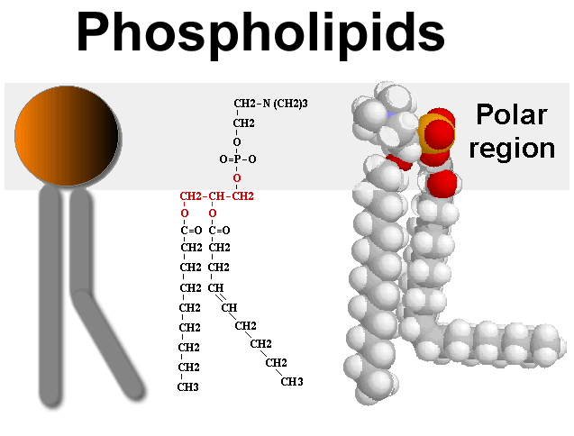
Function in Living Organisms
    Lipids usually serve one of three functions:
    2. Structural support in cell membranes (phospholipids)

Slide 6
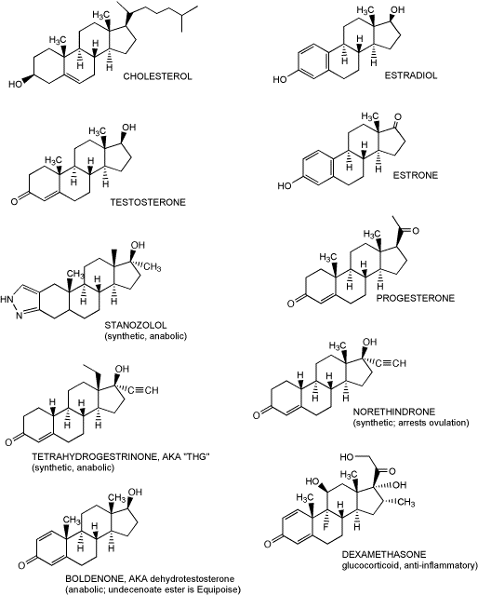
Function in Living Organisms
Lipids usually serve one of three functions:
    3. Serve as messengers
        Steroids are lipids that carry messages through the bloodstream.

Slide 7
Lipid Monomers?
Lipids do not have true monomers

Slide 8
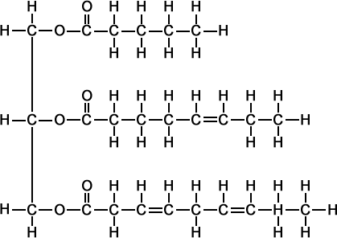
Lipid Polymers
    1 Glycerol
    +
    3 Fatty Acids
    =
    Triglyceride
Glycerol
3 Fatty Acids

Slide 9
Lipid Polymers
A common lipid that contains fatty acids is a Triglyceride.
    They are composed of Glycerol linked to three fatty acids (in the shape of an “E”) by condensation reaction.

Slide 10
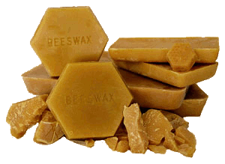

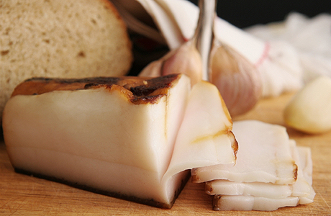

Types of Lipids
    Lipids are Fats, Oils and Waxes
Lipids DO NOT dissolve in WATER

Slide 11
Types of Fatty Acids
    Fatty acids are classified as:
    1. Saturated
    OR
    2. Unsaturated.

Slide 12
Saturated Fatty Acid
      NO DOUBLE BONDS!! (saturated with Hydrogen)
      Usually solid at room temperature, M
      Most come from animal products.
Can you think of some examples?

Slide 13
Unsaturated Fatty Acids
      Have double bond(s) in the carbon chain and are not full.
      Most unsaturated fats are liquid at room temperature(oils)
      Usually come from plants
Can you think of some examples?

Slide 14
Phospholipids

