Slide 1
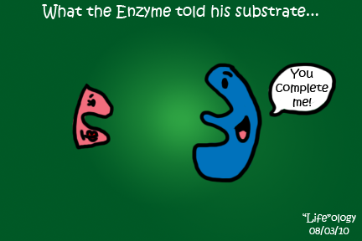
Enzymes (a special protein)
Proteins that catalyze chemical reactions.

Slide 2
Some Vocabulary
Catalyze: increase the rates of
Activation Energy: the minimum energy required to start a chemical reaction.

Slide 3
Some Vocabulary
Substrate: Molecule acted upon by the enzyme
Product: Result of the enzyme/substrate reaction

Slide 4
Some Vocabulary
Active Site: Locations of substrate attachment to enzyme.

Slide 5
Special Proteins
Enzymes help control chemical reactions by acting as catalysts.
Catalysts speed up reactions by lowering activation energy.

Slide 6
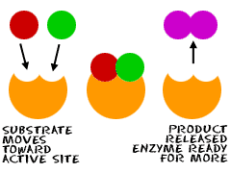
Each enzyme has a certain job and does only that job.
Enzymes are special proteins that build or
break down materials inside or outside the cell.

Slide 7
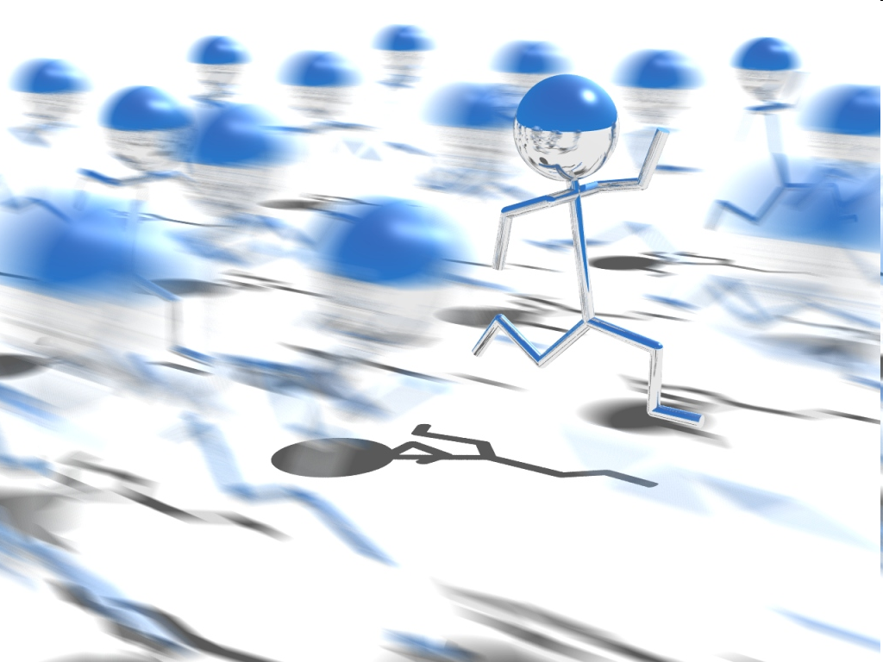
Enzymes the speed of reactions that would otherwise occur slowly.
increase

Slide 8
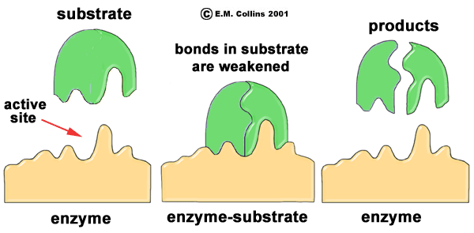
Where might this reaction occur in the body?

Slide 9
Has this reaction caused any change in the structure of the enzyme?

Slide 10
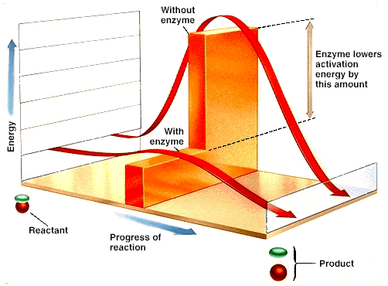
Special Proteins
Enzymes speed up the rate of reaction by DECREASING the ACTIVATION ENERGY

Slide 11
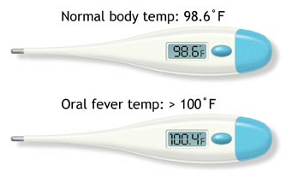
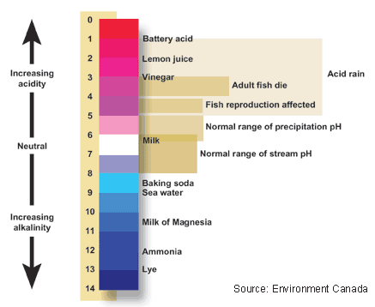
Enzymes and Homeostasis
Temperature
Temperatures above 40◦C (104◦F) denature/destroy enzymes.
pH
Extremely high or low pH values generally result in complete loss of activity for most enzymes.

Slide 12
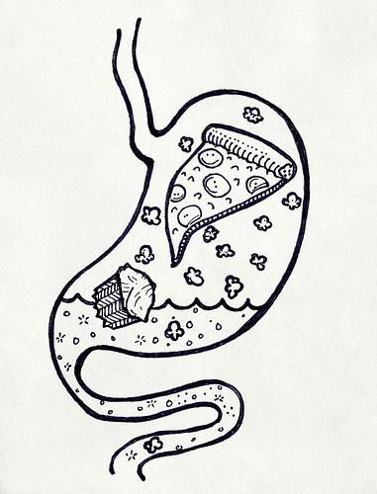
How are Enzymes used in the body???
DIGESTION
INFLAMMATION
during digestion, intestinal cells produce enzymes, which split the food into small molecules so they can be absorbed into the blood
enzymes are produced by neighboring cells, so that the blood clotting process can happen and to remove destroyed tissue.

Slide 13
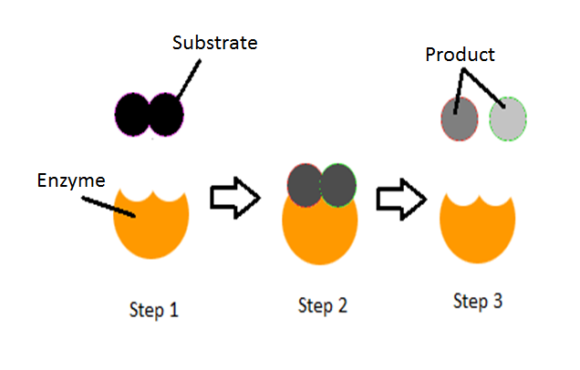

Slide 14
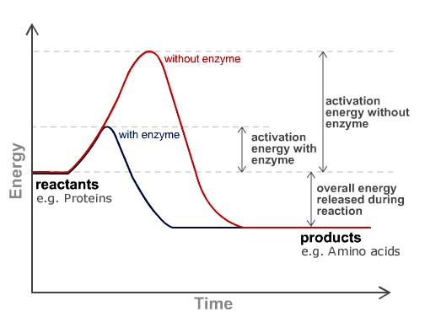
Draw and Label

