Slide 1
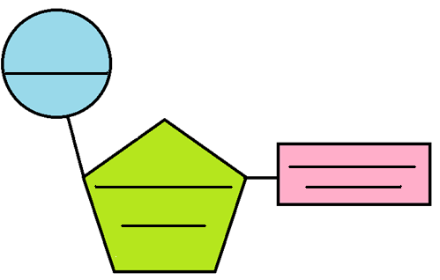
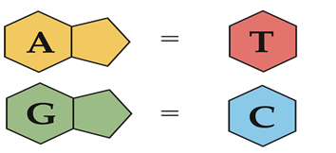
DNA ( _________________________ ______________)
What is DNA?
DNA holds all the ___________________ information that determines an organism’s ____________.
DNA achieves its control by determining the __________________ of ________________.
Nucleotide Structure
DNA Structure
DNA is a ____________ __________ which looks like a twisted ladder.
A DNA strand is a polymer. They are very long!
It’s length is what allows DNA to hold so much information
The repeating subunits of DNA are called _______________
Nucleotides are composed of _________ parts
The ___________________________ groups and _____________________(sugar) molecules bond to form the ________ of the chain
The __________________________ bases stick out like the teeth of a zipper.
DNA Nitrogen Bases
Chargaff’s Rule ( ____________ ______________________)
1 _______________ must bond to 1 __________________
___________________ only bonds with ______________
___________________ only bonds with _______________
A__ T____ G________ C__________

Slide 2
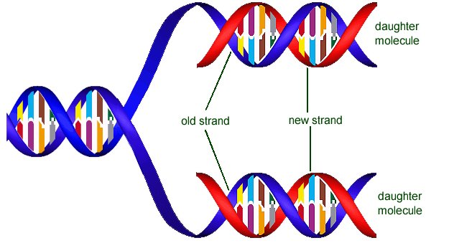
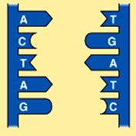
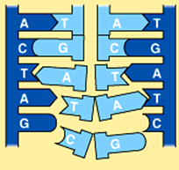
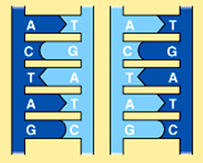
DNA Replication
Occurs during the ________________ of mitosis
Before a cell can divide by mitosis or meiosis, it must first make a copy of its ___________________________.
The process of copying DNA is called ______ ____________________.
DNA is copied during _________________________ prior to mitosis and meiosis.
During replication, each strand serves as a pattern, or __________________, to make a new DNA molecule.
Each ________________ strand remains intact.
Each new DNA molecule is half ________ and half ________.
There are _____ major steps to DNA Replication
Step 1. | Step 2. | Step 3.
DNA Helicase breaks the _______________ __________ between nitrogen bases which “unzips” the DNA. | Enzymes called DNA ______________________ moves along each strand of DNA and adds complimentary _____________. This continues until the entire molecule has been unzipped and replicated. | ~ Once the DNA polymerase has copied the entire DNA strand, they detach. ~ Each of the two DNA strands has ___ parts. The ______________ half and the _________half.
Result?
Each new strand formed is a ­­­­­­­­­­­­­________________________ of one of the original (parent) strand. This results in two DNA molecules that are ___________________________to the original.

Slide 3
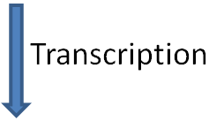
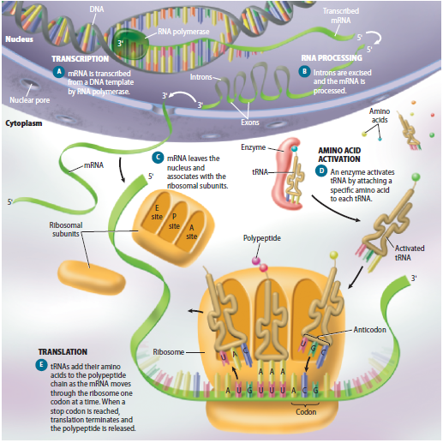
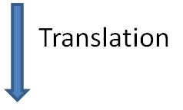

Slide 4
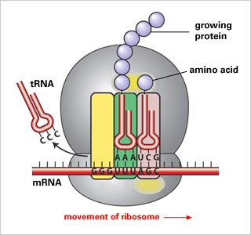
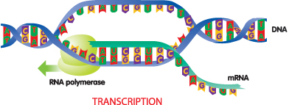
Central Dogma of Protein Synthesis
DNA
mRNA
Protein
Transcription (in nucleus)
Translation (in ribosomes)
WHY IS TRANSCRIPTION IMPORTANT? Because DNA is too __________ to leave the _________, the cell needs to make a messenger that will take the genetic code of DNA from the nucleus to the protein factories (______________) in the cytoplasm. WHAT WILL BE THE MESSENGER? The messenger that transcription produces is called ___________ (the “m” stands for _____________). mRNA is smaller (___________ stranded) than DNA (__________ stranded) and it can fit through the nuclear pores to leave the nucleus. WHAT HAPPENS DURING TRANSCRIPTION? 1. An enzyme called RNA _____________ separates the two DNA strands. 2. RNA polymerase attaches to one of the DNA strands at a start _______________. 3. RNA polymerase moves along the DNA strand, reading the bases and making an ____________ strand. 4. The RNA polymerase _____________ when it hits a stop codon. 5. The DNA will rewind itself back into a _____________
WHY IS TRANSLATION IMPORTANT? Now that the cell has changed the genetic information from ______ into ________, the genetic message can now leave the nucleus and find a _____________, where a protein is _____________. A new type of RNA called ______(___________ RNA) brings ______________ to the ribosome to make a protein. HOW IS A PROTEIN MADE? The mRNA leaves the ___________ and attaches to a ribosome The codons in mRNA match ___________ in tRNA. TRNA ___________ amino acids to the ribosome when they are called for by the codons in mRNA. The ribosome moves down the mRNA strand and each tRNA that brings an amino acid adds to the growing protein.
RIBOSOME

Slide 5
CODING
DNA
mRNA
Protein
Transcription
Translation
RNA is different from DNA Single stranded Thymine has been replaced by Uracil This means coding for transcription will be slightly different then coding for replication How to code DNA into mRNA G→C C→G T→A A→U (DIFFERENT THAN REPLICATION) Practice FINAL PRODUCT IS mRNA
In translation an mRNA strand’s bases will be coded into amino acids (building blocks of proteins) Example: RNA Strand: U C G C A C G G U Reads as: UCG – CAC – GGU (3 codons) Represents the amino acids: Serine – Histidine – Glycine Amino Acids: There are ____ different amino acids, but ____ different codon possibilities, so several codons might represent ____ amino acid. EX: UCU, UCC, UCA, and UCG all code for the amino acid _____________________ There is also one codon ______, that is called the ________ codon because it starts protein synthesis. There are ___ STOP codons that stop protein synthesis FINAL PRODUCT IS A POLYPEPTIDE (PROTEIN CHAIN)
mRNA | AUG | UGA | CCU
Amino Acid
DNA | A | T | G | A | C | C | C | A | G | G | A
mRNA
mRNA | GCG | GAU | UGC
Amino Acid
DNA | T | T | C | A | C | A | G | A | A | T | C | G | A
mRNA

