Slide 1
Cell Transport
Diffusion
Osmosis
Solution Tonicity
Active Transport

Slide 2
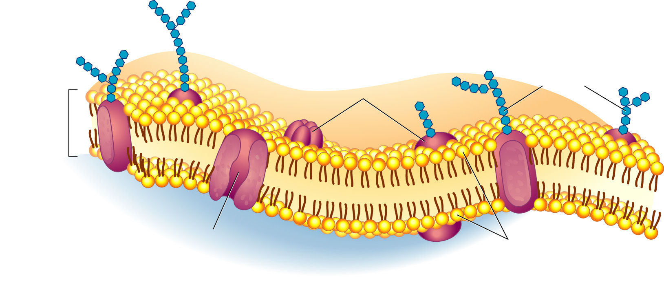
Mosaic of Molecules
Outside
of cell
Carbohydrate
chains
Proteins
Cell
membrane
Inside
of cell
(cytoplasm)
Protein
channel
Lipid bilayer
Phospholipid Bilayer
Embedded proteins form channels and pumps
Attached carbohydrates act as chemical ID cards identifying the cell

Slide 3
Cell Membrane
Regulates what enters and exits the cell
Selectively Permeable
Provides protection and support
Lipid Bilayer
2 Flexible Layers
Forms a strong barrier between the cell and its surroundings
Cell Membrane Video

Slide 4
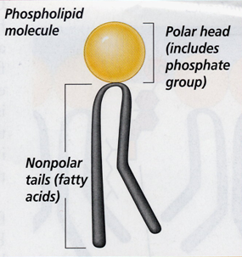
Phospholipid Structure
The polar Phosphate group is Hydrophilic
Water loving
The non polar fatty acid tails are Hydrophobic.
Does not like water

Slide 5
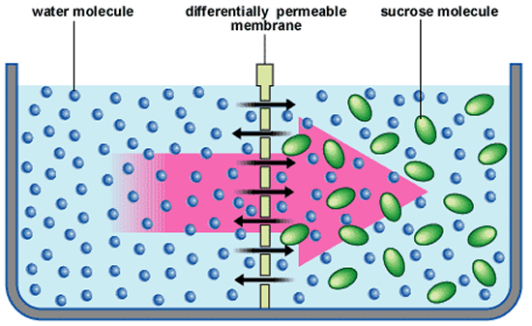
Selectively Permeable
Only allows certain molecules to pass through it.

Slide 6
Diffusion
C
O
N
C
E
N
T
R
A
T
I
O
N
G
R
A
D
I
E
N
T
High Concentration
Movement of particles from an area of high concentration to an area of low concentration without the use of energy.
particles move with the concentration gradient.
Movement of particles
Low
Concentration

Slide 7
Diffusion
When the particles are even
throughout a space - it has reached EQUILIBRIUM

Slide 8
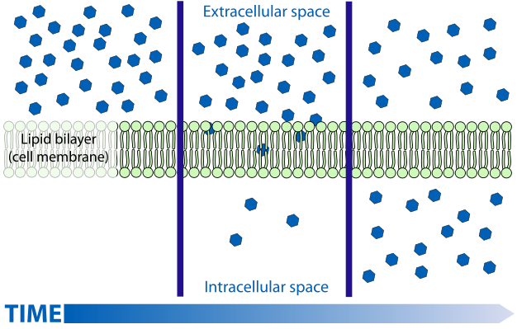
Diffusion Through Cell Boundaries

Slide 9
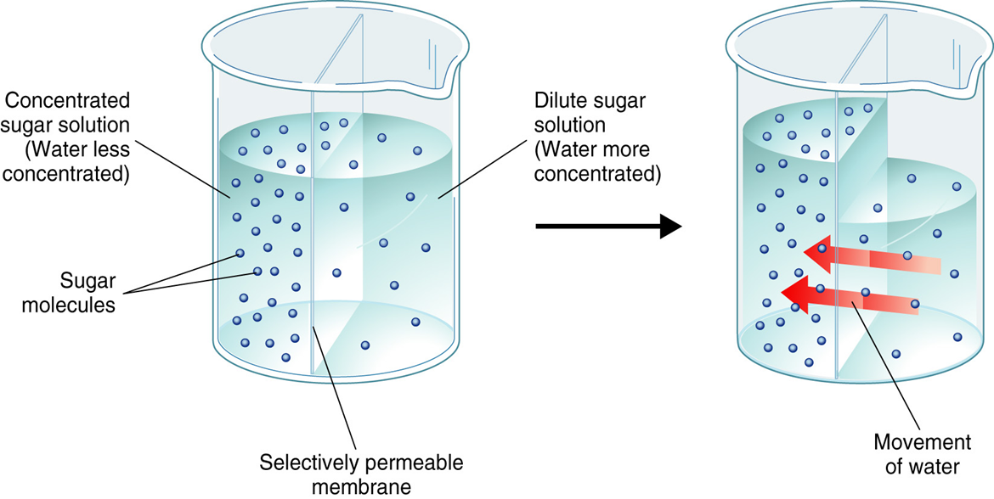
Osmosis
The diffusion of water through a selectively permeable membrane.

Slide 10
Osmotic Pressure
For organisms to survive, they must have a way to balance intake and loss of water.
Osmosis exerts pressure (osmotic pressure) on the hypertonic side of the membrane.

Slide 11
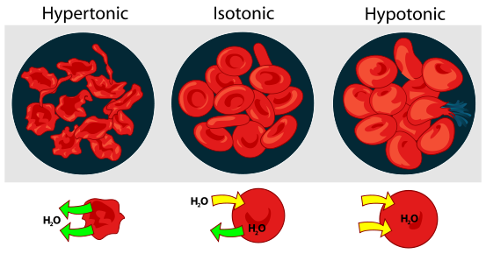
Tonicity
The osmotic pressure or tension of a solution, as in the cells would swell or shrink depending on the tonicity of the environment.
Hypotonic, Isotonic and Hypertonic video

Slide 12
Hypertonic Solutions
Contain a higher concentration of solutes (dissolved substances) than the cell.
Water moves out of the cell causing it to shrivel.
Animal Cell
Plant CEll

Slide 13
Isotonic Solutions
Contain the same concentration of solutes (dissolved substances) as the cell.
Water moves freely in and out of the cell maintaining equilibrium.
Animal Cell
Plant CEll

Slide 14
Hypotonic Solutions
Contain a lower concentration of solutes (dissolved substances) than the cell.
Water moves into the cell causing it to swell and possibly burst.
Animal Cell
Plant CEll

Slide 15
Facilitated Diffusion (Passive Transport)
The movement of particles across the cell membrane with the aid of transport proteins (protein channels).
does not require energy

Slide 16
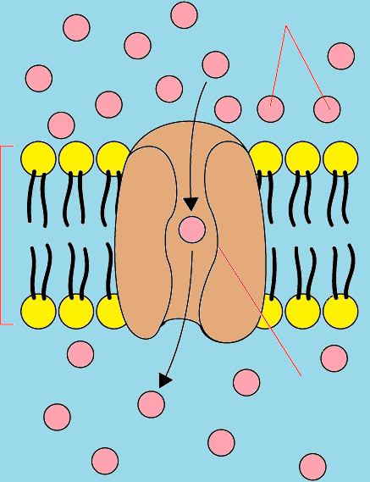
Facilitated Diffusion (Passive Transport)
Glucose
Molecules
High
Concentration
Example: Red blood cells have a channel that allows glucose to pass through it in either direction
Cell
Membrane
Low
Concentration
Protein
Channel
Facilitated Diffusion Video

Slide 17
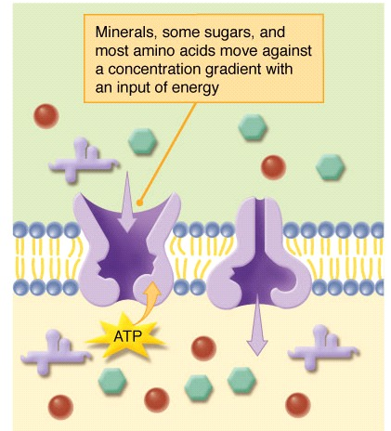
Active Transport
Cells sometimes need to move materials against concentration.
Requires energy
And the help of a membrane protein
Sodium(Na+) Potassium(K+) Pump Video

Slide 18
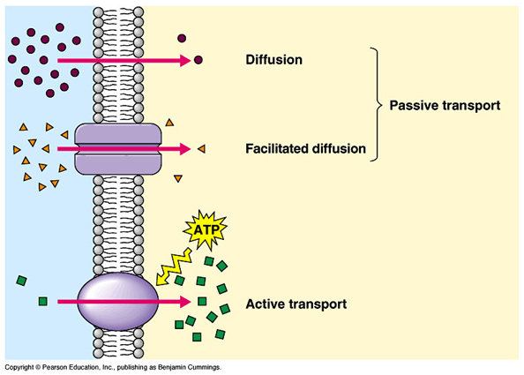
Summary
Does Not
require Energy
Requires Energy

Slide 19
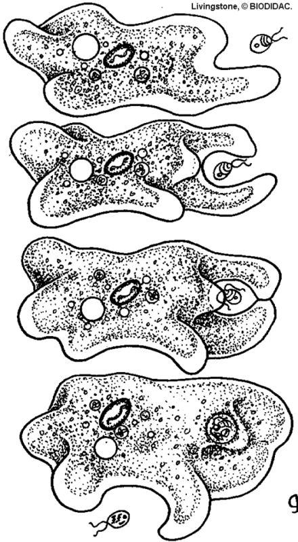
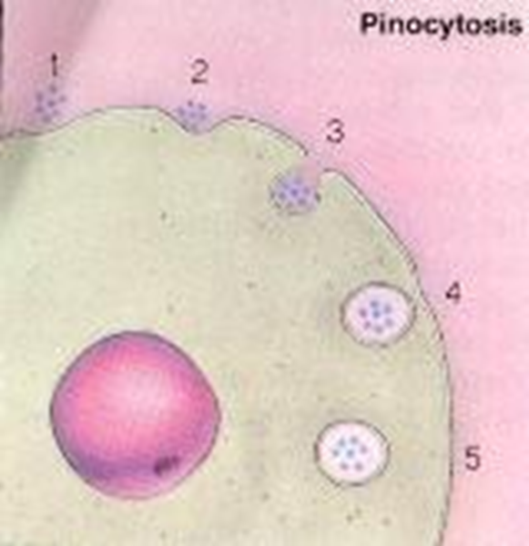
Endocytosis
Large molecules and even solid clumps of materials may be transported into the cell by the folding in of the cell membrane.
Phagocytosis
The taking in of food
Pinocytosis
The taking in of liquids

Slide 20
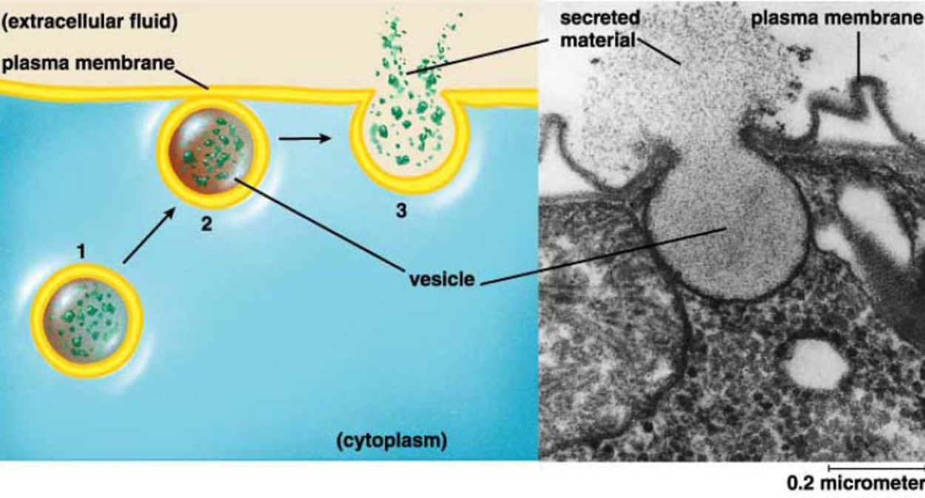
Exocytosis
The release of large amounts of materials from the cell.

