Slide 1
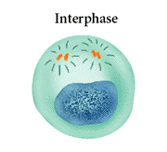
Cell Cycle Notes
Chapter 8

Slide 2
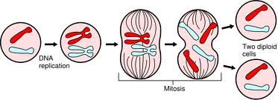
Division of the Cell
Cell division forms two identical “daughter” cells.
Before cell division occurs, the cell replicates all of its DNA.

Slide 3
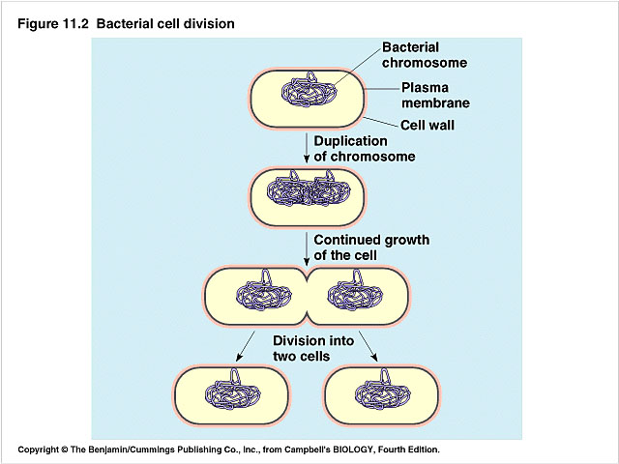
Division of the Cell
Prokaryotes
Lack a nucleus
Have a single chromosome
Reproduce by binary fission
Eukaryotes
Have a nucleus and membrane bound organelles
Interphase = a period of growth and preparation for division
Mitosis = division of nucleus
Cytokinesis = division of cytoplasm
VS.

Slide 4
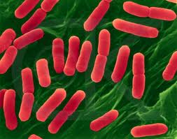
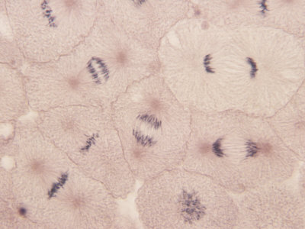
Division of the Cell
Prokaryote
VS.
Eukaryote
Binary fission in E. Coli
Mitosis in White Fish

Slide 5
What are Chromosomes?
Carry the genetic information (traits) of the cell that are passed on from one generation of cells to the next.
Chromatids
A chromatid is basically one half of a chromosome
Prior to cell division, each replicates and consists of two identical sister chromatids.
When the cell divides, the chromatids separate from each other. One chromatid goes to each of the two new cells.
Each pair of chromatids is attached at an area called the centromere.

Slide 6
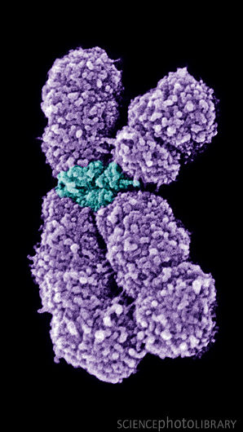
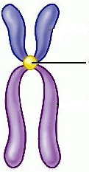
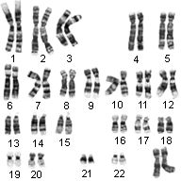
Chromosome Structure
Centromere
Sister Chromatids

Slide 7
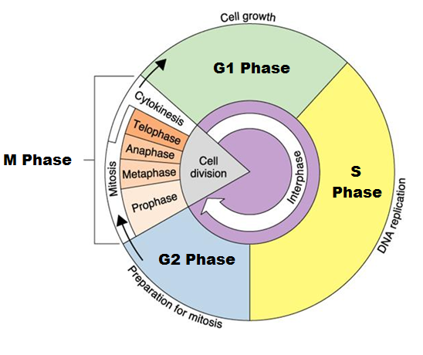
The Cell Cycle
Series of events that cells go through as they grow and divide.
During the cell cycle, a cell Grows, Prepares for division, and divides to form two daughter cells, each of which then begins the cycle again.

Slide 8
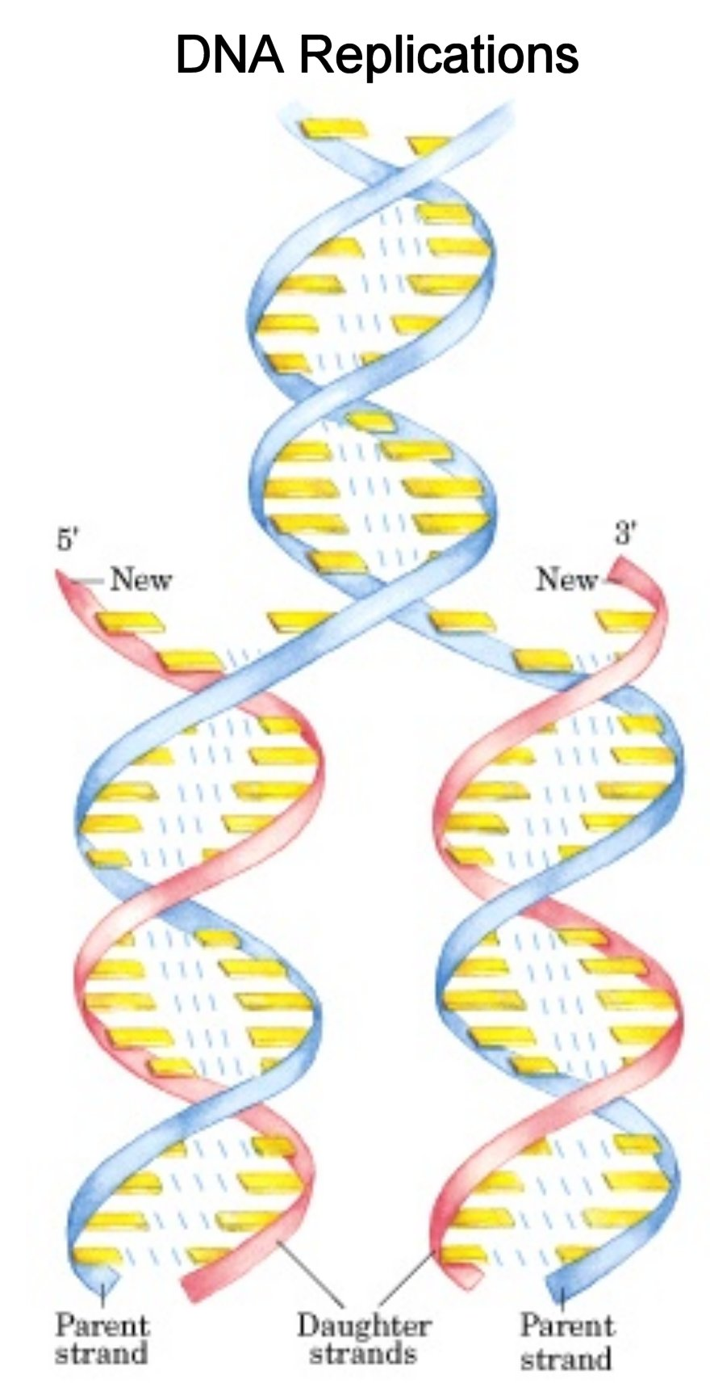
Interphase
Interphase: The longest phase of the cell cycle
G₁ Phase:
Period of cell growth
New proteins & organelles
S Phase:
Chromosomes are replicated
DNA synthesis
G2: The Shortest of the 3 phases
organelles and molecules required for cell division are produced

Slide 9
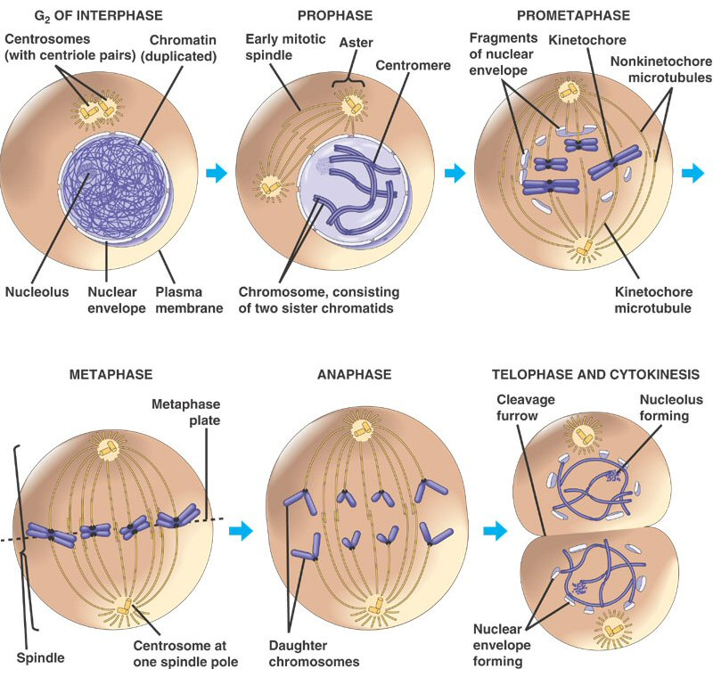
M Phase
Division of the cell
Mitosis
Prophase
Metaphase
Anaphase
Telophase
Cytokinesis
Division of the cytoplasm

Slide 10
M Phase
Includes Mitosis as well as Cytokinesis

Slide 11
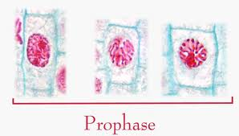
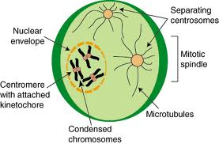
Mitosis
Prophase
Chromosome coil more tightly becoming visible
Centrioles move to poles of the cell
Nucleolus disappears
Nuclear envelope breaks down.

Slide 12
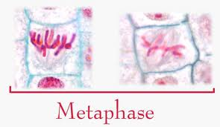
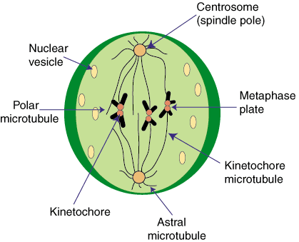
Mitosis
Metaphase
Chromosomes line up across the center of the cell.
The spindle connects the centromere of each chromosome to the two poles.

Slide 13
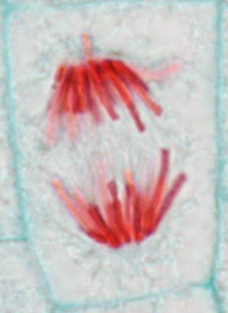
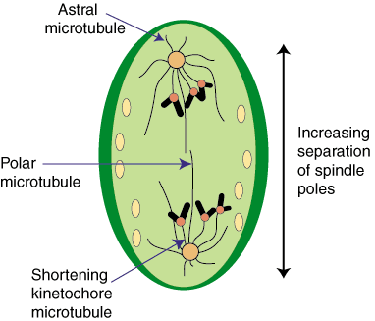
Mitosis
Anaphase
Chromosomes are separated
Spindle fibers shorten so chromosomes are pulled to poles of cell
Ends when the chromosomes stop moving.

Slide 14
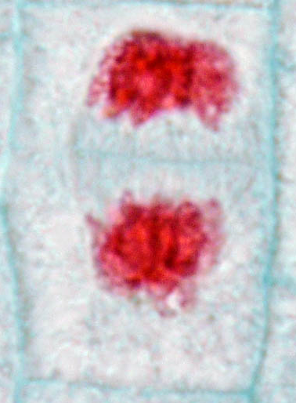
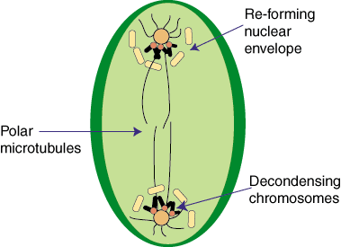
Mitosis
Telophase
Chromosomes uncoil
Nuclear membrane reappears
Mitosis is complete, Cell division is NOT.

Slide 15
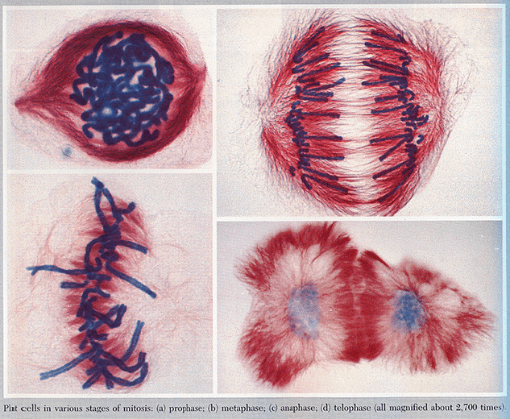
Mitosis
Prophase
Metaphase
Anaphase
Telophase

Slide 16
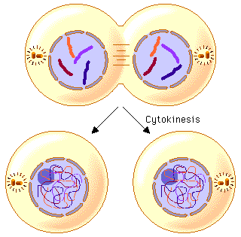
Cytokinesis
At the end of mitosis, 2 nuclei are formed within the cytoplasm of a single cell. All that remains if the division of the cytoplasm.
This usually occurs at the same time as telophase.

Slide 17
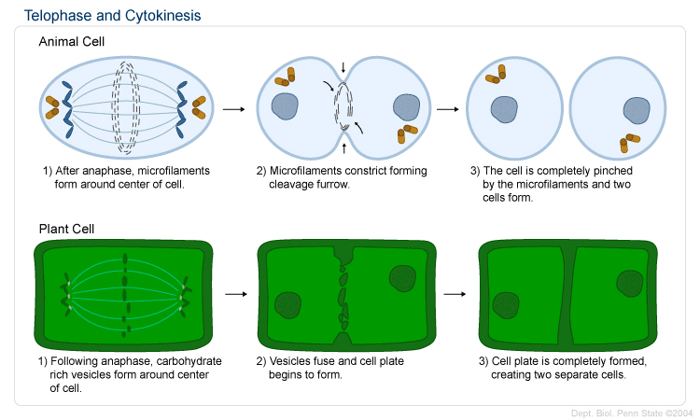
Cytokinesis
Animals
th cell membrane pinches in to form a cleavage furrow
Plants
A cell plate forms midway between the divided nuclei.
VS.

