Slide 1
Carbohydrates
A quick source of energy!!

Slide 2
What elements are carbs composed of?
Carbon (C)
Hydrogen (H)
Oxygen(O)
In a ratio of – C : H
1 : 2
Example: Glucose C₆H₁₂O₆
6
1 : 2
For every 1 Carbon (C) You will have
2 Hydrogens (H)

Slide 3
Function in living organisms
Energy Storage in plants and animals
Starch in plants
Glycogen in animals
Structural support in plants
Cell Walls

Slide 4
STRUCTURE!!

Slide 5
Carbohydrate Monomers (Building Blocks)
Mono=one
Saccharide=sugar
Monosaccharides:
are simple sugars commonly found in rings.

Slide 6
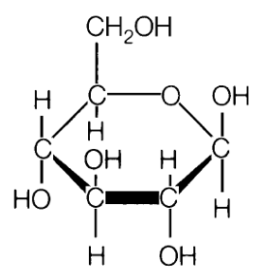
Carbohydrate Monomers (Building Blocks)
Glucose = C₆H₁₂O₆

Slide 7
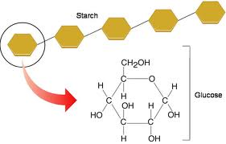
Carbohydrate Polymers
Polysaccharides:
Poly=Many, Saccharide=sugar
Polysaccharides (carbs) are made by linking monosaccharides (simple sugars) together.
They can be very large and complex, or they can be small and made up of only two monomers linked together.
These are called Disaccharides

Slide 8
Carbohydrate Polymers
Disaccharides:
Di=Two, Saccharide=sugar
Disaccharides contain 2 monosaccharides joined by dehydration synthesis.

Slide 9
Complex Carbs
Very Large Carbohydrates (Polysaccharides)

Slide 10
Carbohydrate Examples

Slide 11
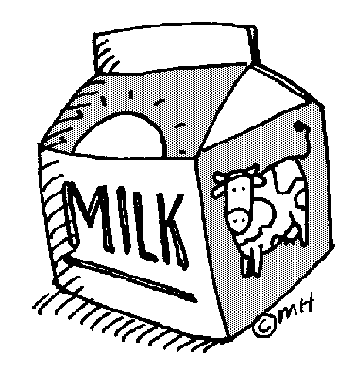
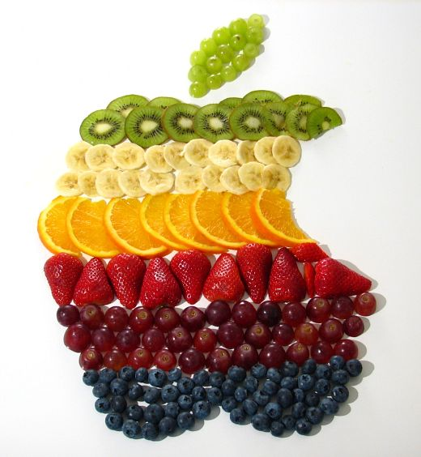
Monosaccharides Monomers (Building Blocks)
SIMPLE SUGARS
Glucose: commonly found in blood of animals
Galactose: a simple sugar found in milk
Fructose: commonly found in fruit

Slide 12
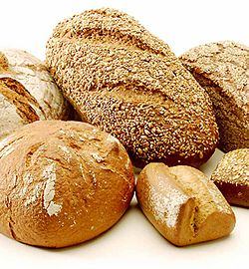
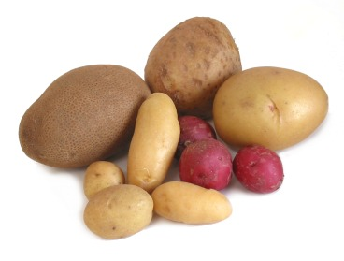
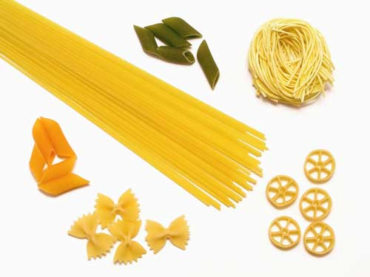
Polysaccharides
Complex Carb (Larger polysaccharide) examples
1. Starch: Glucose (energy) stored in plants
(breads, pasta, potatoes)

Slide 13
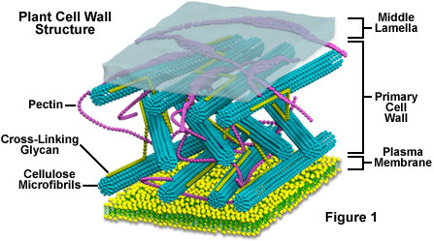
Polysaccharides
Complex Carb (Larger polysaccharide) examples
2. Cellulose: Forms plant cell walls providing strength and rigidity.

Slide 14
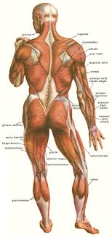
Polysaccharides
Complex Carb (Larger polysaccharide) examples
3. Glycogen: Glucose stored in the
liver and muscle of animals.
Used for quick energy!!!

