Slide 1
Biomolecules
Molecules of Life

Slide 2
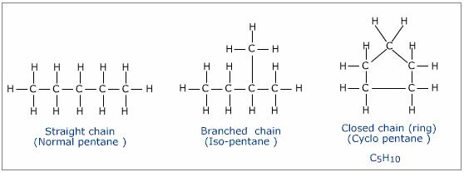
The Chemistry of Carbon
Carbon is the most versatile element
Can form up to 4 bonds at one time.
Carbon may also form bonds with other Carbons allowing for unlimited chain lengths

Slide 3
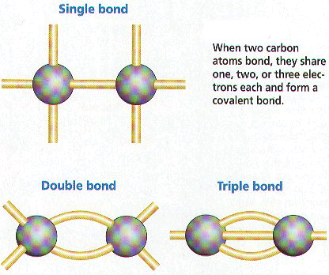
The Chemistry of Carbon
May form 3 types of bond bonds with other Carbons
Single –
Double =
Triple ≡
Can even fold over forming rings

Slide 4
All compounds can be classified into 2 broad categories:
Organic compounds- Contain carbon (C) and hydrogen(H) atoms
Inorganic compounds- Can have one or the other, but do not contain both carbon(C) and hydrogen (H) atoms
Most of your body’s molecules are organic compounds.

Slide 5
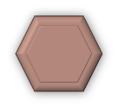
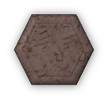
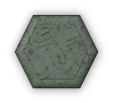
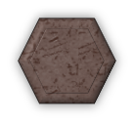
How are biomolecules made?
Monomers connect to form polymers
Monomers
Polymer
H2O
H2O
H2O
Mono = One
H2O
Poly = Many
H2O
H2O
H2O
H2O
H2O
H2O
H2O

Slide 6
How are biomolecules made?
Monomers link to form polymers through a chemical reaction called a condensation reaction or dehydration synthesis. During the formation of polymers, Water (H₂O), is released or is a by-product of the reaction.

Slide 7
How are biomolecules made?
Monomers
Polymer
H2O
H2O
H2O
H2O
H2O
H2O
H2O
H2O
H2O
H2O
H2O

Slide 8
How are biomolecules broken down?
The breakdown of some complex molecules, such as polymers, occurs through a process known as hydrolysis.
Hydrolysis is the reverse of a condensation reaction. The addition of water, to some polymers can break the bonds that hold them together.

Slide 9
Types of Biomolecules
There are four main types of macromolecules found in living organisms:
Carbohydrates
Lipids
Nucleic Acids
Proteins

